Slide 1
Advances in SENSE with Arbitrary k-Space Trajectories
Jaeeun Lee
2018/10/12

Slide 2
Contents
Intro
Theory
Reconstruction Problem
Iterative Solving
Steepest Descent
Conjugacy
Conjugate Gradient
Elimination of Noise Matrix
FT for Matrix-Vector Multiplication
Density and Intensity Correction
Implementation
Gridding
k-space filtering

Slide 3
Intro
non-Cartesian SENSE processing by performing reconstruction iteratively
SNR optimization is accomplished using CG iteration method
Make fast computation possible by combining FFT with forward and reverse gridding operations

Slide 4







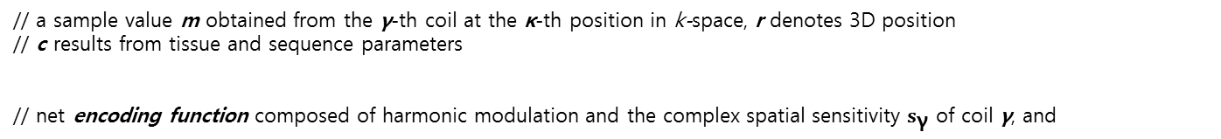
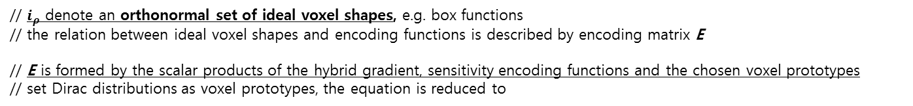
Theory_ a) Reconstruction Problem
Voxel function // reflecting the spatial signal response associated with pixel values
// a sample value m obtained from the γ-th coil at the κ-th position in k-space, r denotes 3D position
// c results from tissue and sequence parameters
// net encoding function composed of harmonic modulation and the complex spatial sensitivity $s_{\text{γ}}$ of coil γ, and
// $n_{v}$ image values is to be calculated as a linear combination of sample values where ρ counts the voxels to be resolved
// reconstruction matrix F, $size(F)=\left[ n_{v} ∗ n_{c}n_{k} \right]$
// voxel function; spatial weighting of signal in $v_{ρ}$
// the matrix F has to be chosen such that the resulting voxel functions approximate the desired voxel shapes.
// $i_{ρ}$ denote an orthonormal set of ideal voxel shapes, e.g. box functions
// the relation between ideal voxel shapes and encoding functions is described by encoding matrix E
// E is formed by the scalar products of the hybrid gradient, sensitivity encoding functions and the chosen voxel prototypes
// set Dirac distributions as voxel prototypes, the equation is reduced to

Slide 5






Theory_ a) Reconstruction Problem
Voxel function // there are many possible ways of approximating ideal voxels.
Weak
// each voxel function fulfil the orthonormality relations of its ideal counterpart
// F : reconstruction matrix E : encoding matrix, (Dirac distributions as voxel prototypes)
// It is underdetermined ; nc*nk exceeds nv -> F should be underdetermined to make Identity
// Means, it has degrees of freedom in the choice of the reconstruction matrix (optimizing SNR)
// the best solution of FE = Id in terms of SNR ; acquired by using Lagrange calculus
// psi tilde denotes the sample noise matrix
// image noise matrix
// Reconstruction equation

Slide 6
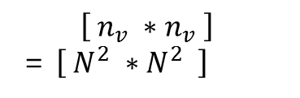
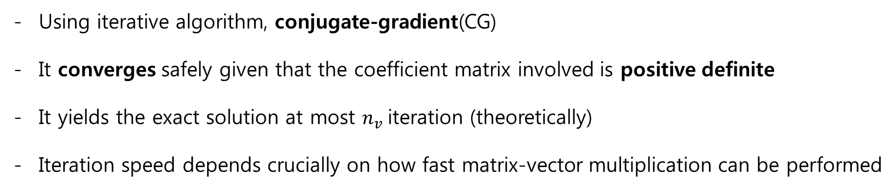
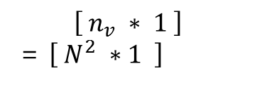
Theory_ b) Iterative Solving
// too large
$$\left[ n_{v} ∗n_{v} \right]$$
= $\left[ N^{2} ∗N^{2} \right]$
$$\left[ n_{v} ∗ 1 \right]$$
= $\left[ N^{2} ∗1 \right]$
Using iterative algorithm, conjugate-gradient(CG)
It converges safely given that the coefficient matrix involved is positive definite
It yields the exact solution at most $n_{v}$iteration (theoretically)
Iteration speed depends crucially on how fast matrix-vector multiplication can be performed

Slide 7




Theory_ b) Iterative Solving
- The Quadratic Form
// if “A : a symmetric and positive-definite” , Ax = b get the min(f(x))
// goal : e -> 0
// $\text{goal}\text{ : }\text{r} \text{−>}\text{ 0}$

Slide 8



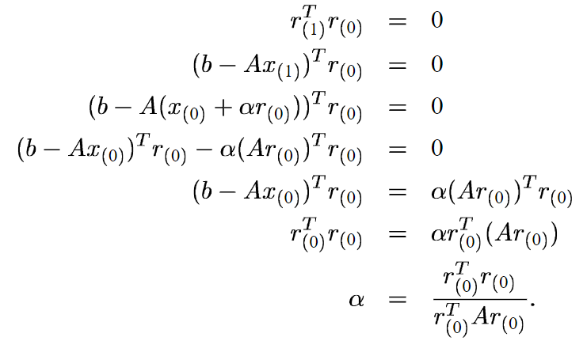


Theory_ b) Iterative Solving
- The Steepest Descent
$$x_{i+1}=x_{i}+ α_{i}d_{i}$$
// search direction, $d_{i}$ : along the direction of steepest descent $= −f^{′}(x_{i})=−r_{i}$
// step size,${ α}_{i}$: choose $α$to minimize $f$ along a line
->

Slide 9
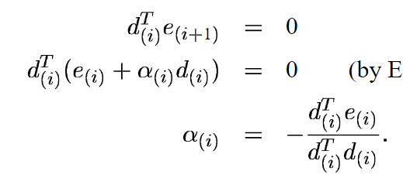
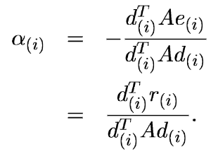


Theory_ b) Iterative Solving
Conjugacy ; search direction = basis
1. Search directions are orthogonal
-> requirement : $x_{i} is orthogonal to e_{i+1}$
2. Search directions are ‘A-orthogonal(conjugate)’
-> requirement : $x_{i} is A−orthogonal to e_{i+1} (=x_{i} is orthogonal to r_{i+1})$
// it is impossible to know ‘e’
// $d_{i}^{T}Ad_{j}=0 , i!=j$

Slide 10
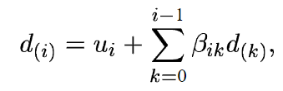
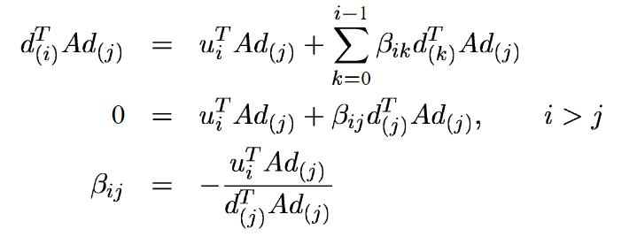
Theory_ b) Iterative Solving
Conjugate Gradient
$$x_{i+1}=x_{i}+ α_{i}d_{i}$$
// search direction, $d_{i}$ : A-orthogonal
// How to set the A-orthogonal search directions?
-> Gram-Schmidt conjugation
// u : a set of n linearly independent vectors

Slide 11

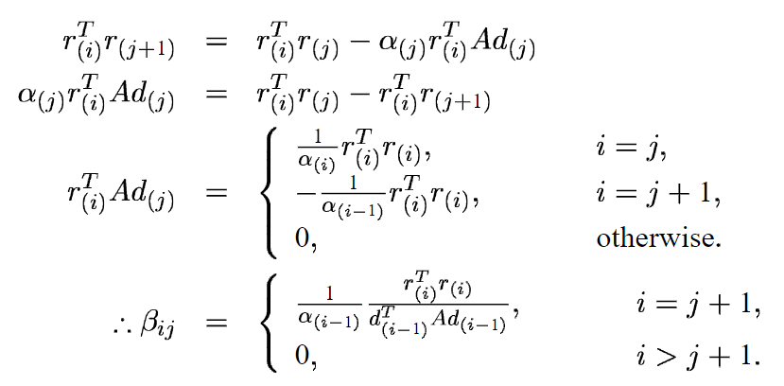
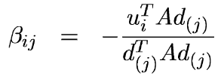

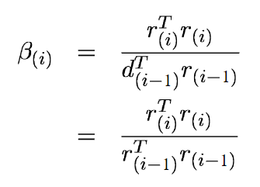


Theory_ b) Iterative Solving
Conjugate Gradient
$$x_{i+1}=x_{i}+ α_{i}d_{i}$$
// How to set the A-orthogonal search directions?
-> Gram-Schmidt conjugation
// How to set the ‘u’?
-> residual // residual become
$$let$$
// No need to save all the previous search vectors

Slide 12
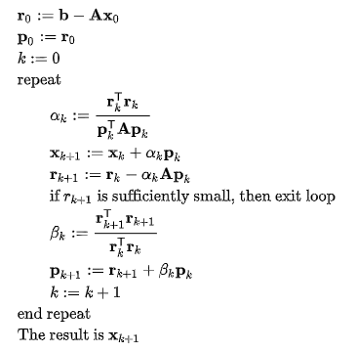
Theory_ b) Iterative Solving
Conjugate Gradient

Slide 13


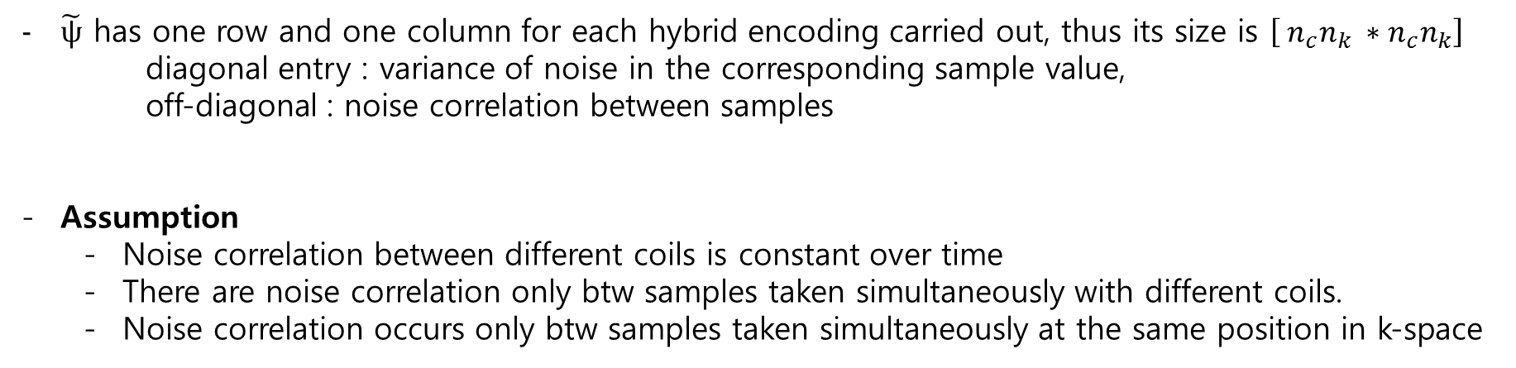
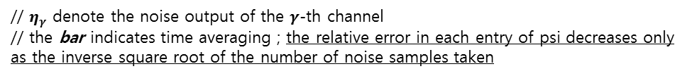
Theory_ c) Elimination of the Noise Matrix
// This equation can be simplified by eliminating the phi
$\tilde{ψ}$ has one row and one column for each hybrid encoding carried out, thus its size is $\left[ n_{c}n_{k} ∗n_{c}n_{k}\right]$
diagonal entry : variance of noise in the corresponding sample value,
off-diagonal : noise correlation between samples
Assumption
Noise correlation between different coils is constant over time
There are noise correlation only btw samples taken simultaneously with different coils.
Noise correlation occurs only btw samples taken simultaneously at the same position in k-space
// $ψ$ denote $\left[ n_{c} ∗n_{c}\right]$time-independent matrix
// noise samples taken in the absence of MR signal
// $η_{γ}$ denote the noise output of the $γ$-th channel
// the bar indicates time averaging ; the relative error in each entry of psi decreases only as the inverse square root of the number of noise samples taken

Slide 14
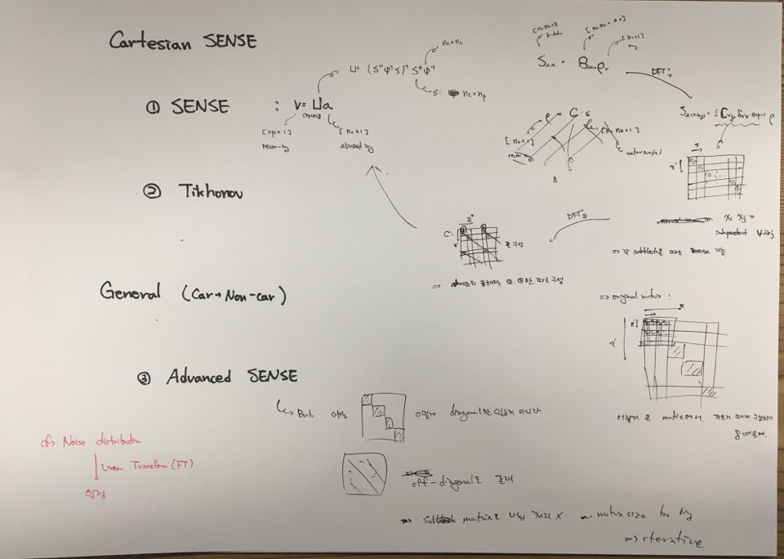
Theory_ c) Elimination of the Noise Matrix

Slide 15





Theory_ c) Elimination of the Noise Matrix
// cholesky decomposition; $phi=USU^{H}=US^{\frac{1}{2}}{ ∗ S}^{\frac{1}{2}}U^{H}=US^{\frac{1}{2}} ∗{\left(US^{\frac{1}{2}}\right)}^{H}= LL^{H}$
// virtual sampling data with decorrelated unit noise; whitened sample value
// net coil sensitivity associated with virtual channel; whitened coil sensitivity
// modified encoding matrix; whitened encoding matrix
// simplify the original equation without SNR compromise
// E drop the superscript for decorrelation

Slide 16





Theory_ d) FT for Matrix-Vector Multiplication
In each CG loop, the matrices $E and E^{H}$ need to be multiplied with some tmp vectors
$E$ have not only hybrid encoding term but also ‘Fourier term’ which have the possibility that make operation efficiently.
// $′s\left(r_{ρ}\right)′ vs ′x_{ρ}′$
// Ex could be thought as superposition of Fourier basis and convolution(sampling(delta func), (coil sensitivity * image))
// ${FT}^{−1}=\frac{1}{k_{κ}}\int{\left(\sum{\sim }\right)e^{ik_{k}r}dr}$
// Ex = apply inverse FT on [coil sensitivity.*image](elemental-wise operation)

Slide 17



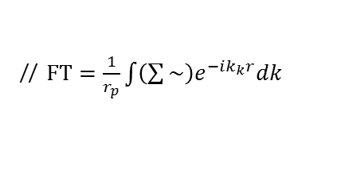
Theory_ d) FT for Matrix-Vector Multiplication
// the right may be regarded as a sum of
k-space integrals weighted by coil sensitivity
// $FT=\frac{1}{r_{p}}\int{\left(\sum{\sim }\right)e^{−ik_{k}r}dk}$

Slide 18


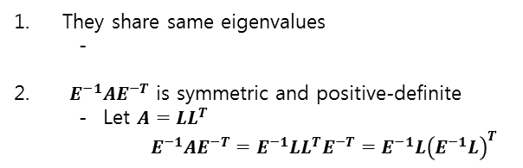
Theory_ e) Density and Intensity Correction
Preconditioning
Improving the condition of a matrix
// M is a symmetric, positive-definite matrix that approximates A
// eigenvalues of $M^{−1}A$ are better clustered
// However, $M^{−1}A$ is not generally symmetric nor definite, even if M and A are
-> let’s use $E^{−1}AE^{−T}$ instead of $M^{−1}A$ ($M=EE^{T}$)
They share same eigenvalues
-
$E^{−1}AE^{−T}$ is symmetric and positive-definite
Let $A=LL^{T}$
$E^{−1}AE^{−T}=E^{−1}LL^{T}E^{−T}=E^{−1}L{\left(E^{−1}L\right)}^{T}$

Slide 19




Theory_ e) Density and Intensity Correction
Density correction
// RHS(an intermediate image) is created by gridding and FT, followed by sensitivity-weighted summation for each coil element
// this equation does not involve any correction for inhomogeneous k-space density
// Density correction of the sample vector m is performed by the diagonal matrix
// d(k) denotes the relative density of the k-space sampling pattern at the position k
// the effect of D is negligible with moderately changed d(k) (regular types of trajectories),
yet may be considerable with d(k) which has drastic change (e.g., random sampling)

Slide 20
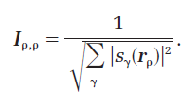


Theory_ e) Density and Intensity Correction
Intensity correction ; for computational speed
// the image $E^{H}Dm$ is weighted by the sum-of-squares of coil sensitivities.
// inverse square-root of this weighting factor
// $I^{2}E^{H}DE$ is no longer safely positive-definite

Slide 21
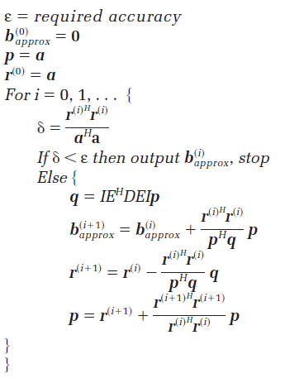



Theory_ f) Implementation
$$a=IE^{H}Dm$$
$$b=I^{−1}v$$
$$\left(IE^{H}DEI\right)b=a$$
$$v=Ib$$
$$b_{0}=0$$
$$r_{0}=a$$
$$d_{0}=a$$
$δ=\frac{\left|IE^{H}DEIb−a\right|}{|a|}=\frac{r_{i}^{H}r_{i}}{a^{H}a}$ // accuracy

Slide 22

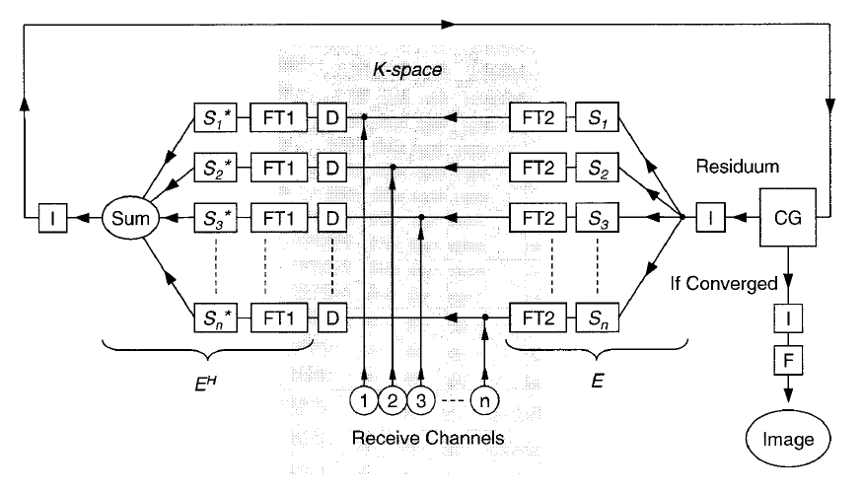


Theory_ f) Implementation
1. Let Ip = x
2. Multiply D
3. Let DEIp = y
3. Multiply I

Slide 23
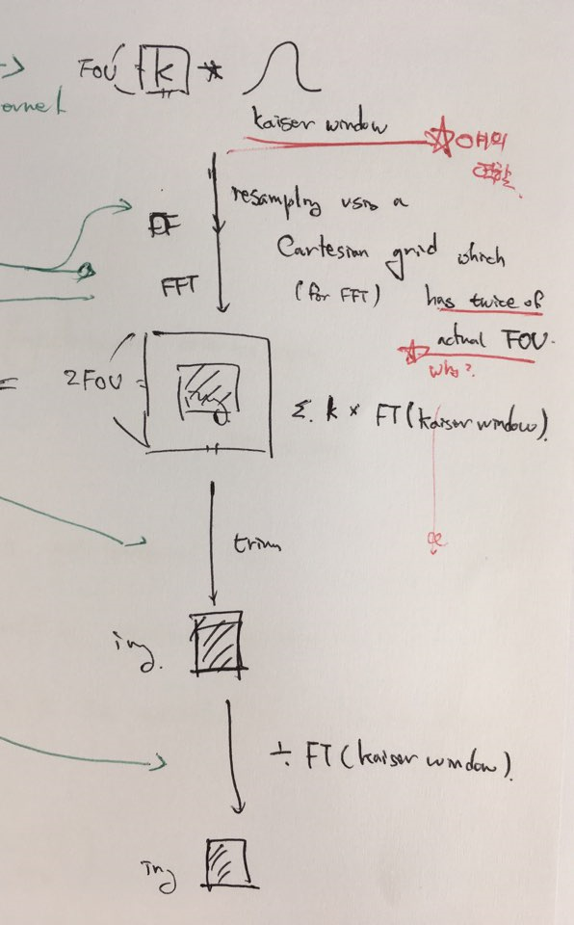
Theory_ f) Implementation
FT1
1. Convolve with gridding kernel
2. Twofold oversampling along Cartesian grid
3. FFT to image domain
4. Trim image matrix
5. Divided by Fourier transform of gridding kernel

Slide 24
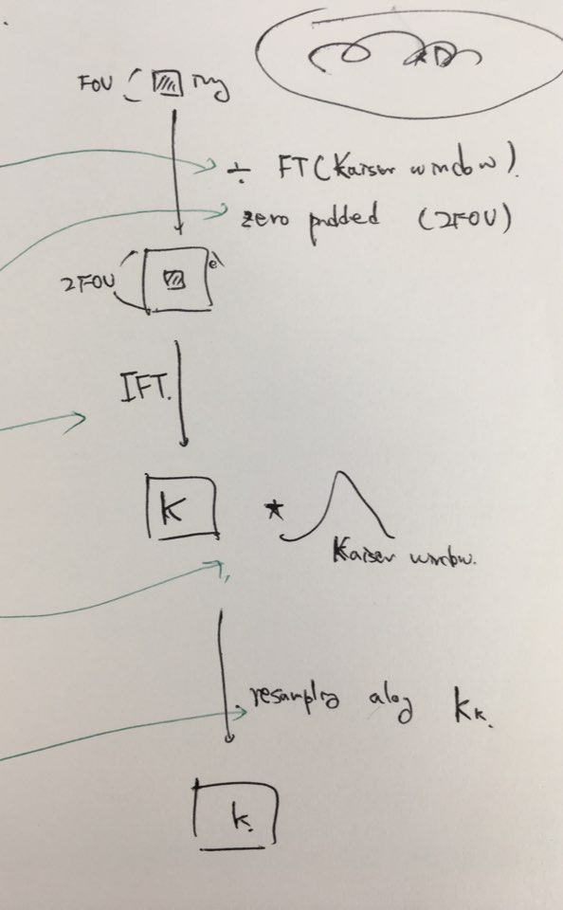
Theory_ f) Implementation
FT2
1. Divide by Fourier transform of gridding kernel
2. Double image matrix and zero-pad
3. Inverse FFT to k-space
4. Convolve with gridding kernel
5. Resample along non-standard trajectory

Slide 25
Theory_ g) k-space filtering
- When the k-space trajectory used does not cover the entire, rectangular k-space region, the information from the corners of k-space could not be yield directly.
- The coil sensitivity have nonfinite Fourier representations which permit collecting infor-mation also from regions away from the actual k-space trajectory.
However, coil sensitivities have only small information on high frequency. As a consequence, the calculation of getting high frequency info from coil sensitivities should be ill-posed problem (intense noise contamination occurs).
We can relieve noise-amplification by using k-space filtering process.
Multiply the filter function on inverse Fourier transformed solution(ifft(v)), then apply fft.

Slide 26

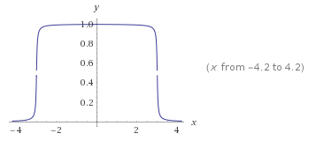
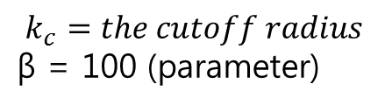
Theory_ g) k-space filtering
$$k_{c}=the cutoff radius$$
$\text{β}\text{ = 100}$ (parameter)
// $k_{c}=3$

